Slide 1
4. Political Legal Environment

Slide 2
Understanding the Political Environment
What is the Political Environment?
Refers to government regulations, legal aspects, and political actions impacting business operations.
Involves political philosophy, structure, parties, and institutions.
Influences business decisions, strategies, and time management.
Significance for Business:
Crucial for developing economic frameworks.
Impacts business strategies and policies.
Can influence factors like economic policy, government spending, and tax systems.

Slide 3
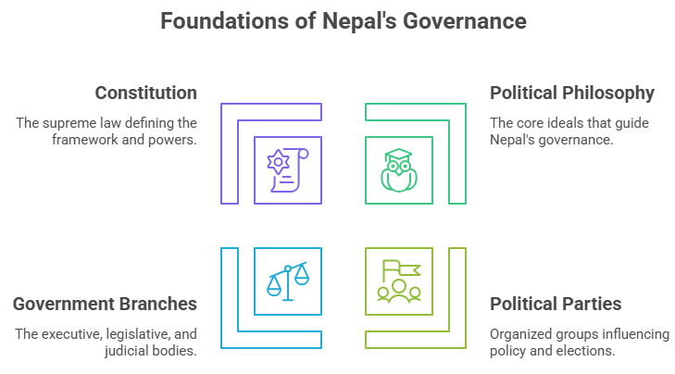

Slide 4
Understanding Political Philosophies
Types and Nature of Political Philosophy
Autocratic Philosophy:
Characterized by a single ruler with absolute or dictatorial authority.
Restricts individual freedom and exercises high degree of control over public and private life.
No popular participation or checks on power.
Democratic Philosophy:
Power derives from the people through representation.
Ensures free and fair elections, protection of human rights, and rule of law.
Emphasizes public participation, economic activity, equality, and justice.
Nepal's Context: Nepal has adopted a democratic ideology and is a federal democratic republic with a multi-party democratic system.

Slide 5
Defining the Constitution
The fundamental principles, rights of citizens, political system, and power exercises of the state.
The present governing constitution of Nepal is the Constitution of Nepal 2015.
Historical Context of its Formation:
Nepal has gone through several constitutional assemblies.
The interim constitution of 2007 led to the first constituent assembly, which failed.
The second constituent assembly successfully promulgated the new constitution on January 22, 2015.
This constitution (2015) is divided into 35 Parts, 308 Articles, and 9 Schedules.
It serves as the supreme law guiding all government actions and fundamental rights of citizens.

Slide 6
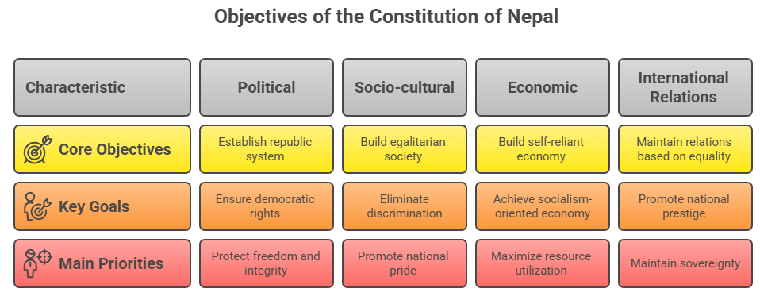
Core Principles of the Constitution of Nepal

Slide 7
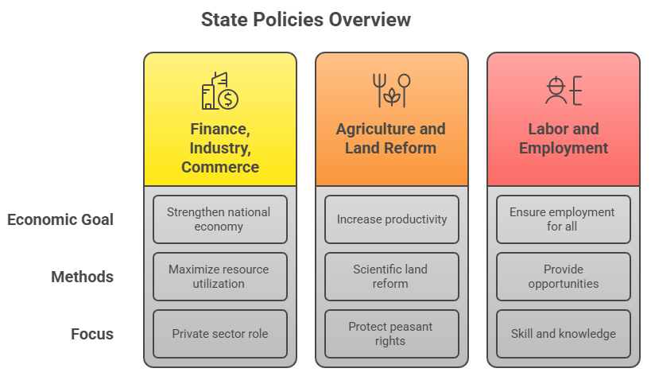
Policies of the state

Slide 8
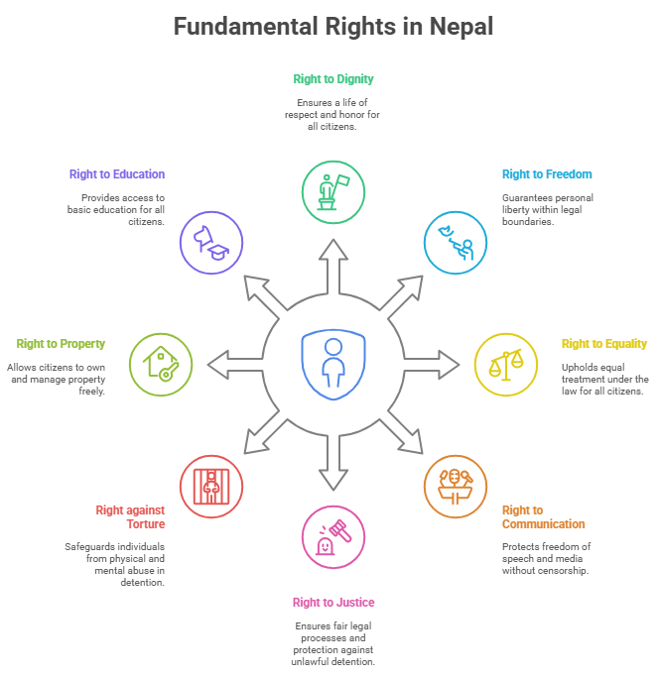

Slide 9
Branches of Nepalese Government
In Nepal, the government structure is based on a federal democratic republican system, established by the Constitution of Nepal 2015.
This system divides governmental powers into three main branches: the Legislature, the Executive, and the Judiciary, operating at federal, provincial, and local levels to ensure checks and balances and decentralized governance.

Slide 10
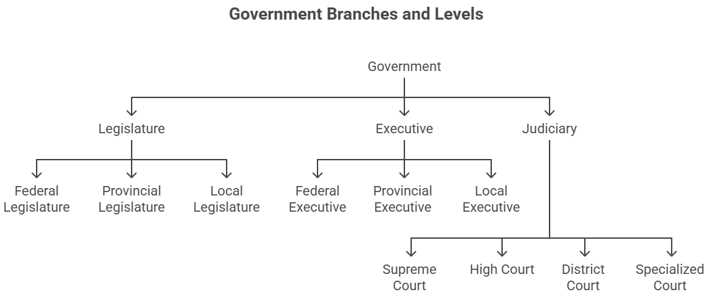

Slide 11
Legislature
This branch is responsible for making laws.
Federal Legislature: This is the bicameral Parliament at the central level, consisting of the House of Representatives and the National Assembly. It makes laws applicable nationwide.
Provincial (State) Legislature: Each of Nepal's seven provinces has its own unicameral Provincial Assembly, which legislates on matters within its provincial jurisdiction.
Local Legislature: At the local level (municipalities and rural municipalities), there are local assemblies that enact local laws and regulations.

Slide 12
Executive
This branch is responsible for implementing laws and governing the country.
Federal Executive: This is the Council of Ministers, headed by the Prime Minister, who is the chief executive of the country. They are responsible for national policy-making and administration.
Provincial (State) Executive: Each province has a Provincial Council of Ministers, led by a Chief Minister, responsible for implementing provincial laws and policies.
Local Executive: At the local level, there are executive bodies (e.g., Mayor/Chairperson and their executive committees) responsible for local administration and service delivery.

Slide 13
Judiciary
This branch is responsible for interpreting laws and administering justice.
Supreme Court: This is the highest court in Nepal, located in Kathmandu. It has the final authority on legal interpretation and constitutional matters.
High Court: Below the Supreme Court, there are High Courts established in each province, which hear appeals from lower courts and have original jurisdiction in certain cases.
District Court: These are the primary courts at the district level, dealing with most civil and criminal cases.
Specialized Court: The Constitution also allows for the establishment of specialized courts, tribunals, or benches for specific types of cases (e.g., administrative courts, labor courts) as needed.

Slide 14
Political Parties in Nepal: An Overview
Role of Political Parties
Indispensable component of a democratic system.
Many parties participate in the political process.
They articulate ideologies, make proclamations, and declare goals.
Influence government formation and business activities.
As of 2080/08/26 (Nepali calendar), 118 political parties were registered with the Election Commission of Nepal.

Slide 15
Major National Political Parties
Nepali Congress (NC):
Social-democratic political party.
Largest opposition party in the House of Representatives and National Assembly.
Historically significant, formed in 1950, and led the first democratically elected government in 1959.
Secured 89 out of 275 seats in the 2023 elections (HoR).
The Nepal Communist Party (UML):
Largest communist party in Nepal.
Ruled the country for three and a half years through unification with CPN (Maoist Centre).
Secured 79 seats in the 2023 elections (HoR).
The Nepal Communist Party (Maoist Centre):
Formed in 2018 through the unification of two leftist parties (CPN-UML and CPN-Maoist Centre).
Experienced internal conflicts leading to fragmentation.
Secured 32 seats in the 2023 elections (HoR).

Slide 16
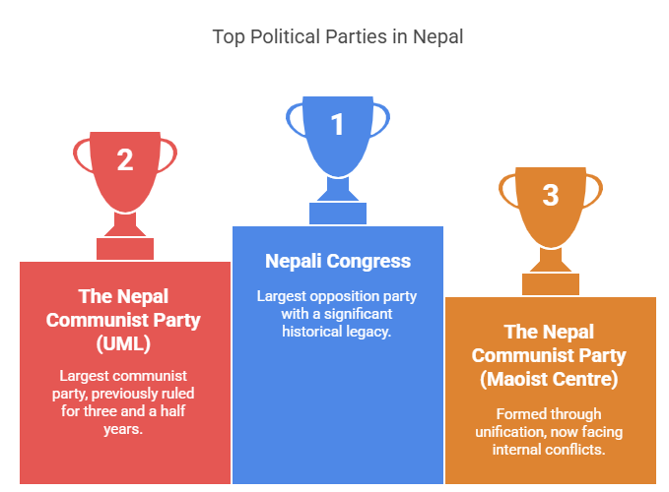

Slide 17
Other Significant National Parties
National Independent Party:
Led by Rabi Lamichhane.
Emerged as the fourth largest party in the 2022 election.
Won 21 seats out of 275 representatives (HoR).
National Democratic Party:
Registered in the Election Commission in 1990.
Currently led by Rajendra Prasad Lingden.
Secured 14 seats in the 2022 election (HoR).
The People's Socialist Party (PSP), Nepal:
Third largest party after Nepali Congress and UML in the 2022 election.
Won 12 seats out of 275 representatives (HoR).

